Slide 1
Introducción a Azure ASP.NET MVC
Germán Küber
Student Partner
Microsoft Argentina & Uruguay

Slide 2
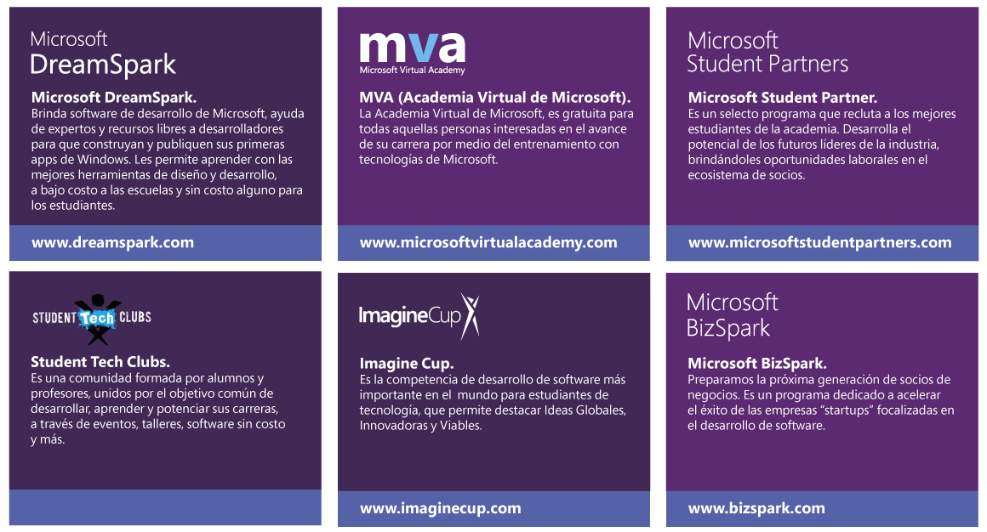
Microsoft en la Academia

Slide 3


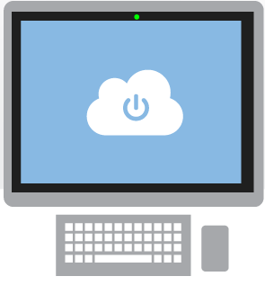

Que es la nube?
Es un acercamiento al procesamiento de datos online, escalables y conectados a una variedad de dispositvos y servicios.
Notes:
-Que es la Nube
-Microsoft Azure
-Beneficios

Slide 4

Notes:
It’s a mobile first / cloud first world
The number of smart devices connected to the internet passed the number of people on the planet in 2008. This will only keep growing at a faster rate.
Cheap storage and easy access to computing power has shifted developer interest to the cloud.
Lots of interesting new possibilities but also some pain points for devs and businesses:
How do I reach people across a multitude of devices?
Does doing so mean learning new skills? If so, at what cost?
How do I stand out in a sea of apps? How can I reach more platforms more easily?
Over 2 billion PCs, 5B phones and 7B people. Expecting 50 billion devices by 2020 and 10 trillion items with smart technology in them. In 2008 the number of connected devices surpassed people.

Slide 5
¿Porque la nube?
Rápido aprovisionamiento de entornos.
Rapido escalamiento para responder a las demandas.
Aumenta la productividad, la eficiencia y reduce costos.
Speed
Scale
Economics

Slide 6






Microsoft Azure Services
Office Add-in
PC
Tablet
Phone
Browser
Games console
On-premises service
On-premises database
Client layer
(on-premises)
Access Control
Layer
AD
Multifactor
Authentication
BizTalk Services
Service Bus
CDN
Traffic Manager
Virtual Networks
Express Route
Integration
layer
API Mgmt
Mobile Services
Websites
Cloud Services
VM
Media Services
Notification Hubs
Scheduler
Automation
Application
layer
Blobs
Tables
Queues
SQL Database
Machine Learning
HD Insight
Caching
Backup and Recovery
StorSimple
Data Layer
Storage
Data

Slide 7
Websites

Slide 8

Supported Publishing Methods
FTP://
TFS
WebDeploy
DropBox

Slide 9




Supported Web Frameworks
Or any custom FastCGI Handler

Slide 10

Develop apps with…
.NET
Python
Node.js
Java
PHP

Slide 11
















Microsoft Azure Web App Gallery
Ready-to-Go Open Source
Web Applications,
Frameworks,
and Templates

Slide 12
Scale

Slide 13
Manual Scaling
Instance Count
1
6
Instances

Slide 14
AutoScale

Slide 15
AutoScale

Slide 16
AutoScale

Slide 17
Auto-Scaling (Metric)
Instance Count
2
6
Instances
[Metric]
60
80
Percent
CPU Percentage | Memory Percentage | Disk Queue Length | HTTP Queue Length | Data In | Data Out

Slide 18
ASP.NET MVC System.Web.Mvc
public class HomeController : Controller
{
public ActionResult Votes()
{
… //Some data processing
return View(VotesData);
}
…
}
CONTROLLER
MODEL
VIEW
[DataContract]
public class VoteModel
{
[DataMember]
public string PostName { get; set; }
[DataMember]
public string UserName { get; set; }
[DataMember]
public bool Vote { get; set; }
}
@model IEnumerable<VoteModel>
@{
ViewBag.Title = “Votes page";
}
<div class="row">
<div class="col-xs-12">
<ul>
@foreach(var vote in Model.Where(it => it.Vote))
{
<li>@vote.UserName - @vote.PostName </li>
}
</ul>
</div>
</div>

Slide 19
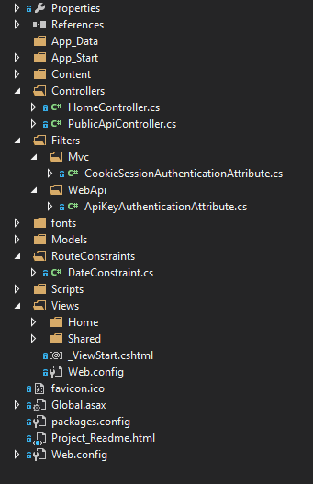
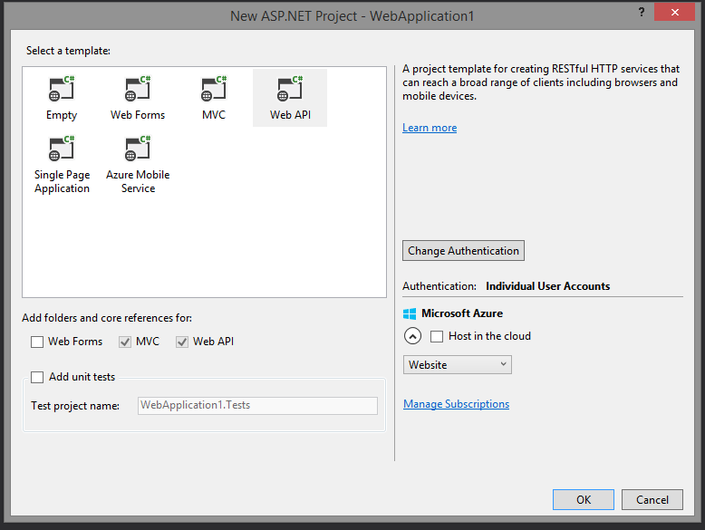
ASP.NET MVC and ASP.NET WebAPI both can be part of same project if you want

Slide 20
Web request
WEB SERVER
Web browser / Device
ASP.NET MVC app
HTTP / HTTPS REQUEST
www.mydomain.com
www.mydomain.com/Archive/2014-04-04
ASP.NET WebAPI app

Slide 21
Web request
public class HomeController : Controller
{
public async Task<ActionResult> Index()
{
return View();
}
public async Task<ActionResult> PostArchive(DateTime date)
{
return View(date);
}
…
}
http://www.mydomain.com
http://www.mydomain.com/Archive/2014-04-04
http://www.mydomain/api/posts/
[RoutePrefix("api")]
[ApiKeyAuthentication]
[CookieSessionAuthentication]
[Authorize]
public class PublicApiController : ApiController
{
[HttpGet]
[Route("posts/{id}")]
public async Task<IEnumerable<PostViewModel>> GetPosts(string id = null)
{
//Do something
retrun ResultDataCollection
}
…
}

Slide 22

¡GRACIAS! ☺
© 2012 Microsoft Corporation. All rights reserved. Microsoft, Windows, Windows Vista and other product names are or may be registered trademarks and/or trademarks in the U.S. and/or other countries.
The information herein is for informational purposes only and represents the current view of Microsoft Corporation as of the date of this presentation. Because Microsoft must respond to changing market conditions, it should not be interpreted to be a commitment on the part of Microsoft, and Microsoft cannot guarantee the accuracy of any information provided after the date of this presentation. MICROSOFT MAKES NO WARRANTIES, EXPRESS, IMPLIED OR STATUTORY, AS TO THE INFORMATION IN THIS PRESENTATION.

